Slide 1
Create an AMI from an Amazon EC2 Instance

Slide 2
Before going to how to Create an AMI from EC2 instance,go ahead and launch instance as per your requirement and launch your application on instance
Ensure your application is up and running so that we can use AMI for Autoscaling directly

Slide 3
To create an AMI from an instance
Right-click the instance you want to use as the basis for your AMI, and choose Create Image from the context menu.

Slide 4
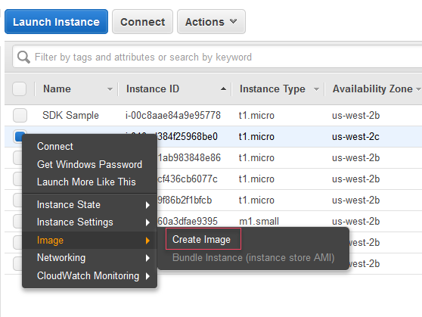

Slide 5
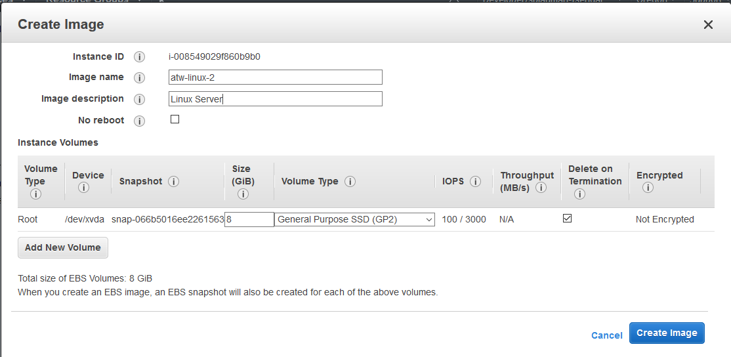
In the Create Image dialog box, type a unique name and description, and then choose Create Image.

Slide 6
It may take a few minutes for the AMI to be created. After it is created, it will appear in the AMIs view in AWS Explorer.
To display this view, double-click the Amazon EC2 | AMIs node in AWS Explorer. To see your AMIs, from the Viewing drop-down list, choose Owned By Me.
You may need to choose Refresh to see your AMI. When the AMI first appears, it may be in a pending state, but after a few moments, it transitions to an available state.

Slide 7
